Slide 1

Manavdhan Samajik Shaikshanik
Vikas Sanstha, Nashik
YEARLY CALENDAR
2026-27

Slide 2
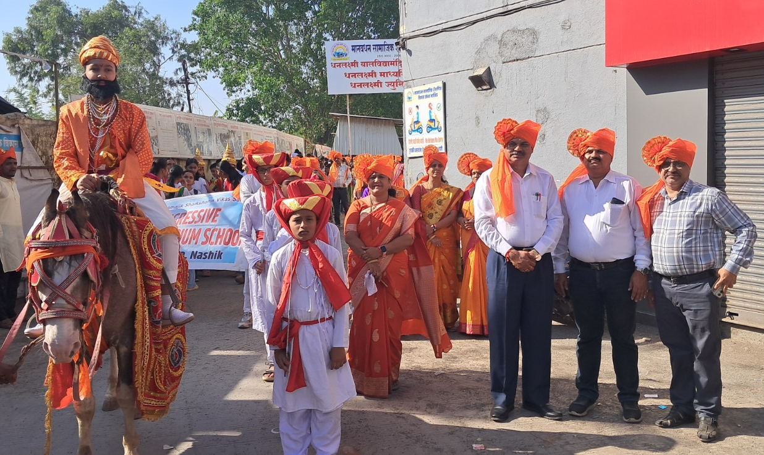
May 2026
S | M | T | W | T | F | S
31 |  |  |  |  | 1 | 2
3 | 4 | 5 | 6 | 7 | 8 | 9
10 | 11 | 12 | 13 | 14 | 15 | 16
17 | 18 | 19 | 20 | 21 | 22 | 23
24 | 25 | 26 | 27 | 28 | 29 | 30
CLASS ACTIVITIES
1st May Maharashtra Day School Rally
EVENTS
1st May Maharashtra Day
2nd May Open House
HOLIDAYS
3rd May to 14th June Summer Vacation

Slide 3
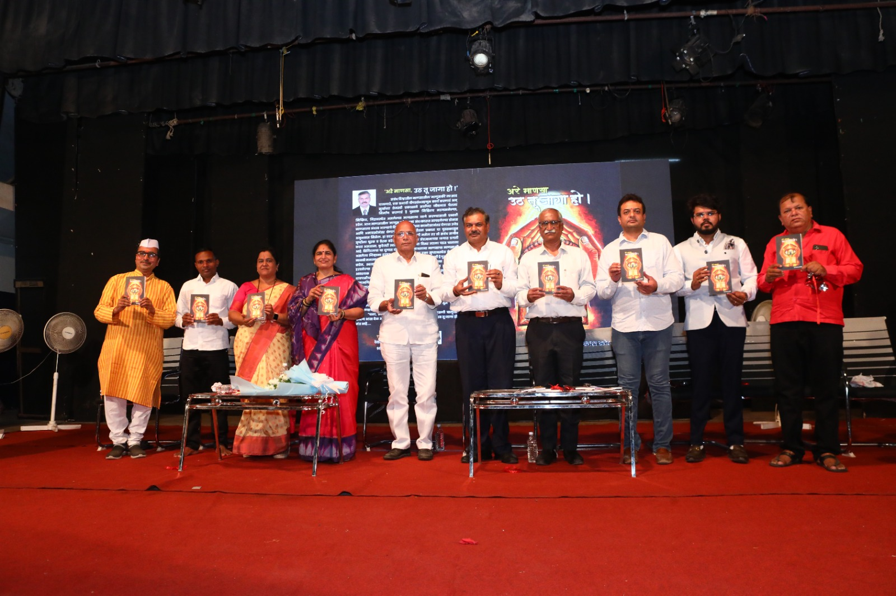
June 2026
S | M | T | W | T | F | S
 | 1 | 2 | 3 | 4 | 5 | 6
7 | 8 | 9 | 10 | 11 | 12 | 13
14 | 15 | 16 | 17 | 18 | 19 | 20
21 | 22 | 23 | 24 | 25 | 26 | 27
28 | 29 | 30
CLASS ACTIVITIES
1st to 10th Yoga Day
EVENTS
1st June X std School Reopens
5th June Founder’s Day
15th June School Reopens
21st June Yoga Day & Father’s Day
HOLIDAYS
26th June Moharram

Slide 4
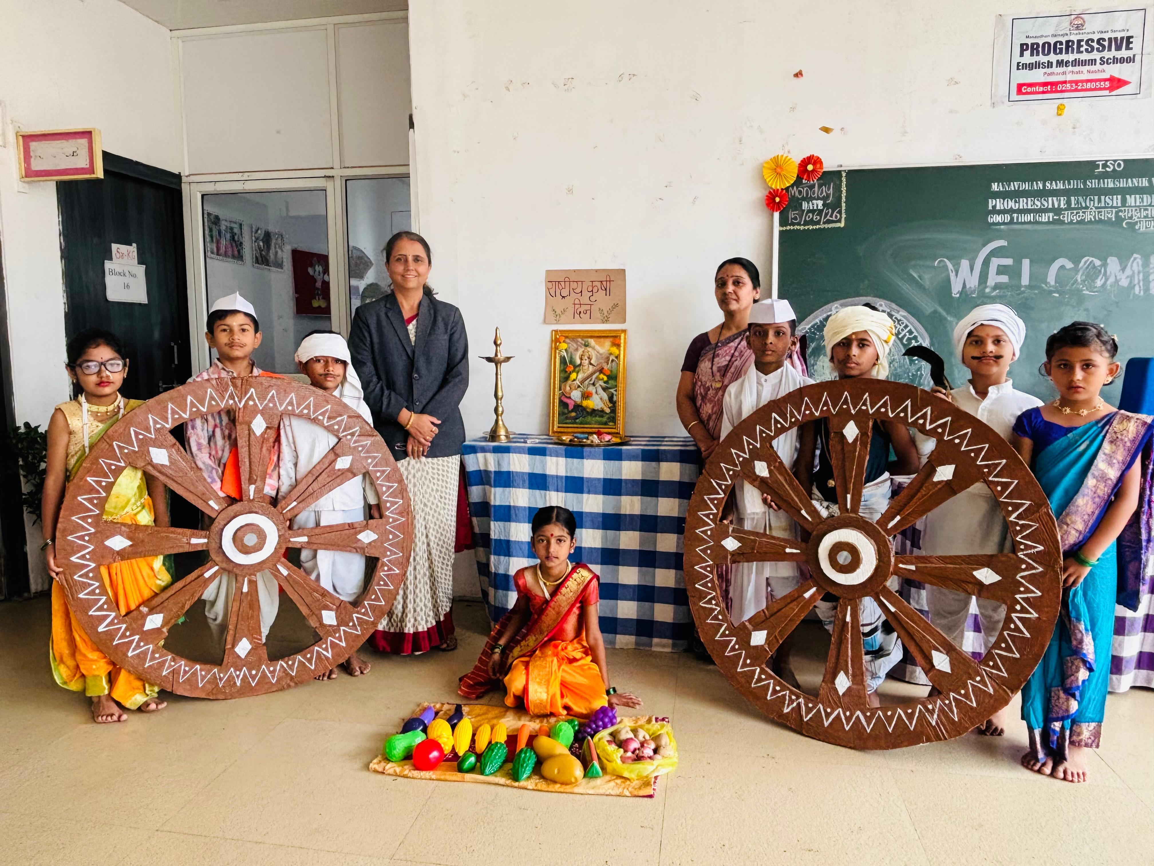
July 2026
S | M | T | W | T | F | S
 |  |  | 1 | 2 | 3 | 4
5 | 6 | 7 | 8 | 9 | 10 | 11
12 | 13 | 14 | 15 | 16 | 17 | 18
19 | 20 | 21 | 22 | 23 | 24 | 25
26 | 27 | 28 | 29 | 30 | 31
CLASS ACTIVITIES
1st to 4th Book Mark making Activity
5th to 8th Handwriting Competition
EVENTS
1st July Dr’s Day & Farmer’s Day
29th July Guru Purnima
HOLIDAYS
25th July Ashadi Ekadashi

Slide 5
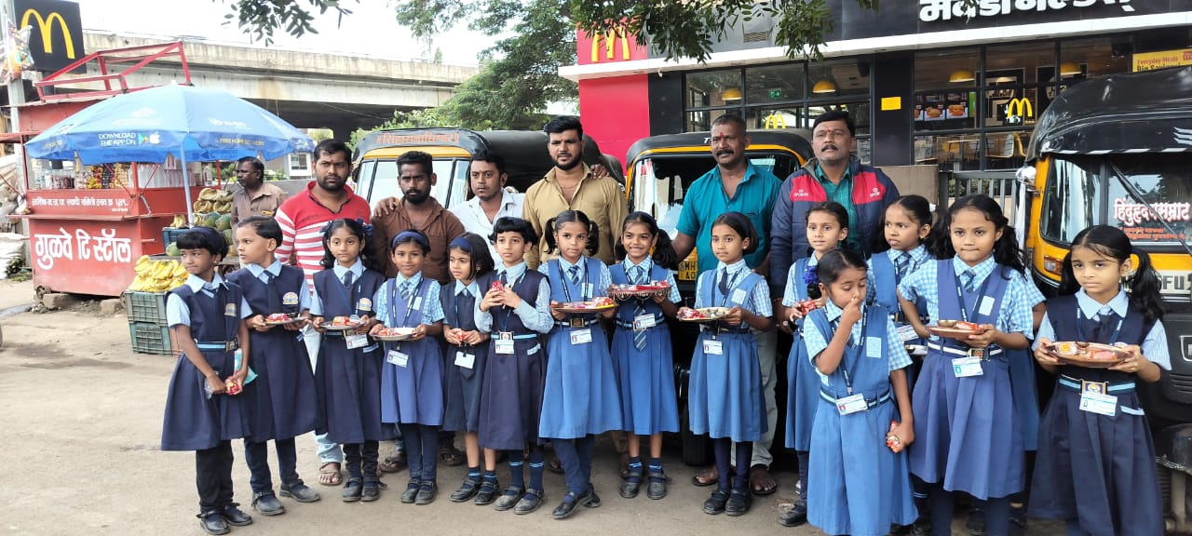
August 2026
S | M | T | W | T | F | S
30 | 31 |  |  |  |  | 1
2 | 3 | 4 | 5 | 6 | 7 | 8
9 | 10 | 11 | 12 | 13 | 14 | 15
16 | 17 | 18 | 19 | 20 | 21 | 22
23 | 24 | 25 | 26 | 27 | 28 | 29
CLASS ACTIVITIES
1st to 4th Rakhi Making
5 to 8th Lokmanya Tilak Oratory Competition
EVENTS
3rd to 13th Aug I Unit Test
15th Aug Independence Day
22nd Aug Open House
29th Aug National Sports Day
HOLIDAYS
26th Aug Eid-E-Milad
28th Aug Raksha Bandhan

Slide 6
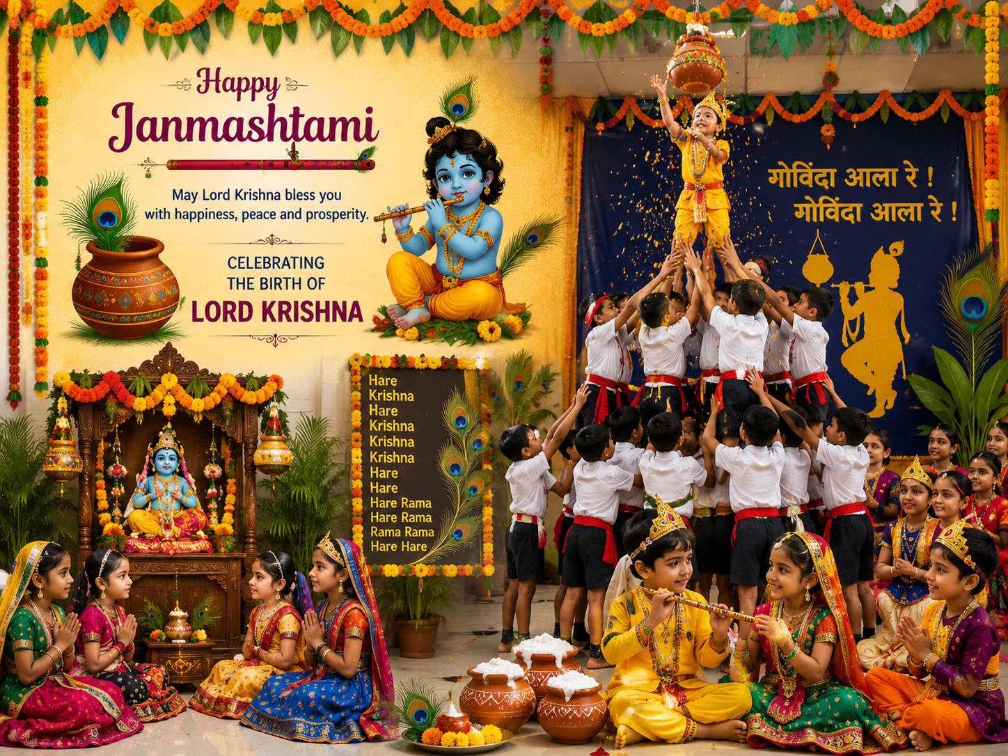
September 2026
S | M | T | W | T | F | S
 |  | 1 | 2 | 3 | 4 | 5
6 | 7 | 8 | 9 | 10 | 11 | 12
13 | 14 | 15 | 16 | 17 | 18 | 19
20 | 21 | 22 | 23 | 24 | 25 | 26
27 | 28 | 29 | 30
CLASS ACTIVITIES
1st to 4th Paper Art Making
5th to 8th Slogan Making competition
EVENTS
5th Sept Teacher’s Day & Janmashtami
HOLIDAYS
14th Sept Ganesh Chaturthi
25th Sept Anant Chaturdashi

Slide 7
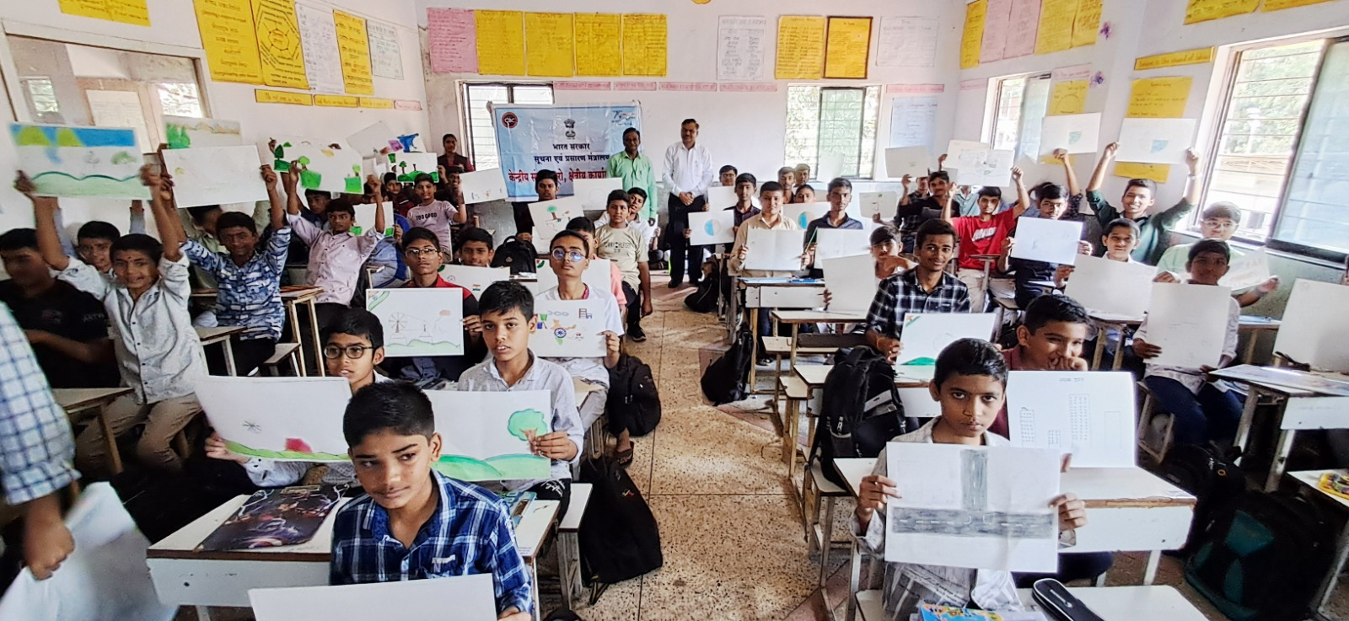
October 2026
S | M | T | W | T | F | S
 |  |  |  | 1 | 2 | 3
4 | 5 | 6 | 7 | 8 | 9 | 10
11 | 12 | 13 | 14 | 15 | 16 | 17
18 | 19 | 20 | 21 | 22 | 23 | 24
25 | 26 | 27 | 28 | 29 | 30 | 31
CLASS ACTIVITIES
1st to 4th Memory Strength Activity
5th to 8th Rangoli Competition
EVENTS
19th Oct to 30th Oct I Semester
HOLIDAYS
2nd Oct Mahatma Gandhi Jayanti
20th Oct Dusshera

Slide 8
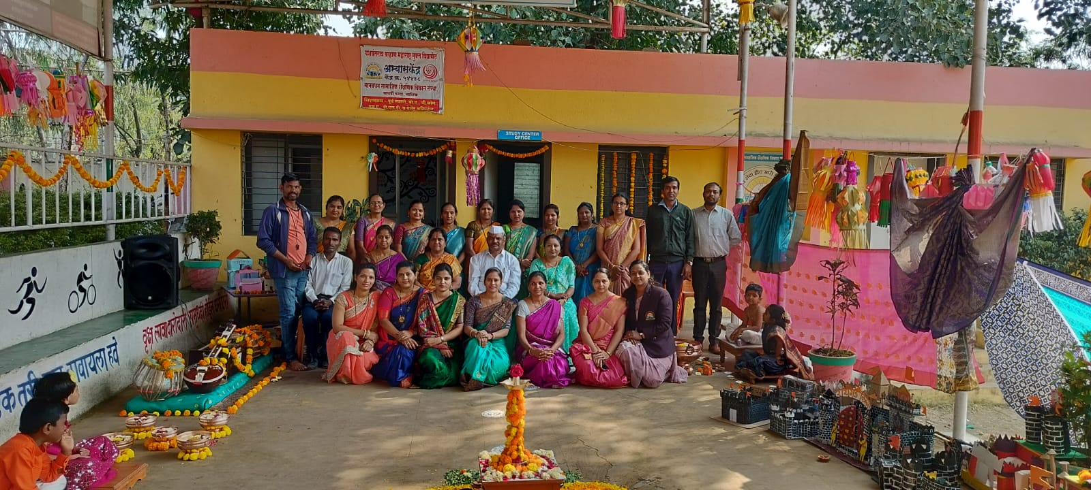
November 2026
S | M | T | W | T | F | S
1 | 2 | 3 | 4 | 5 | 6 | 7
8 | 9 | 10 | 11 | 12 | 13 | 14
15 | 16 | 17 | 18 | 19 | 20 | 21
22 | 23 | 24 | 25 | 26 | 27 | 28
29 | 30
CLASS ACTIVITIES
1st to 4th Mask Making Activity
5th to 8th English Debate Competition
EVENTS
14th Nov Open House
16th Nov School Reopens
17th Nov X std 1st Prelim
HOLIDAYS
2nd Nov to 22th Nov Diwali Vacation
24th Nov Guru Nanak Jayanti

Slide 9
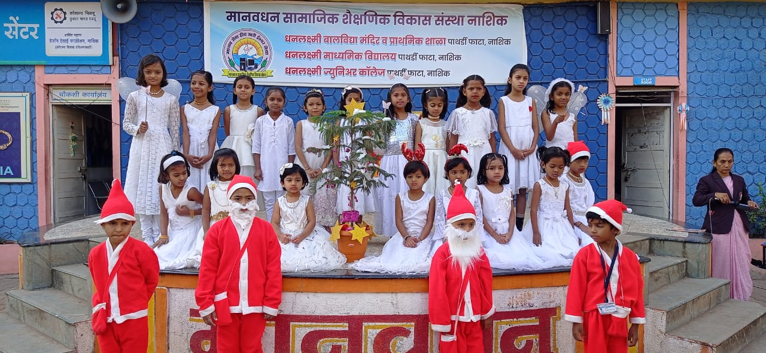
December 2026
S | M | T | W | T | F | S
 |  | 1 | 2 | 3 | 4 | 5
6 | 7 | 8 | 9 | 10 | 11 | 12
13 | 14 | 15 | 16 | 17 | 18 | 19
20 | 21 | 22 | 23 | 24 | 25 | 26
27 | 28 | 29 | 30 | 31
CLASS ACTIVITIES
1st to 4th Marathi/Eng Story Telling
5th to 8th Speed Math Competition
EVENTS
19th Dec Annual Function
22nd Dec Math Day
HOLIDAYS
25th Dec Christmas

Slide 10
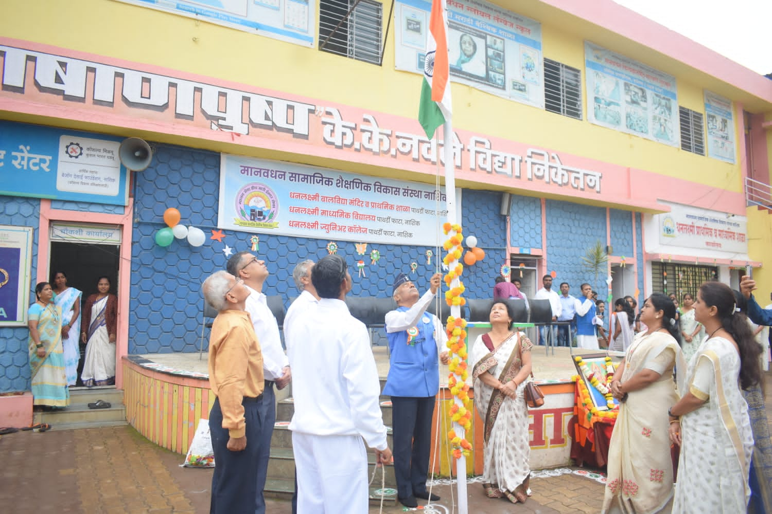
January 2027
S | M | T | W | T | F | S
31 |  |  |  |  | 1 | 2
3 | 4 | 5 | 6 | 7 | 8 | 9
10 | 11 | 12 | 13 | 14 | 15 | 16
17 | 18 | 19 | 20 | 21 | 22 | 23
24 | 25 | 26 | 27 | 28 | 29 | 30
CLASS ACTIVITIES
1st to 4th Symbolic Material making
5th to 8th Musical Instrument Playing competition
EVENTS
2nd Jan Savitribai Phule Jayanti
5th Jan to 14th Jan II Unit Test
12th Jan Class Photo
23rd Jan II Open House & X Farewell
26th Jan Republic day
HOLIDAYS
15th Jan Makar Sankranti

Slide 11
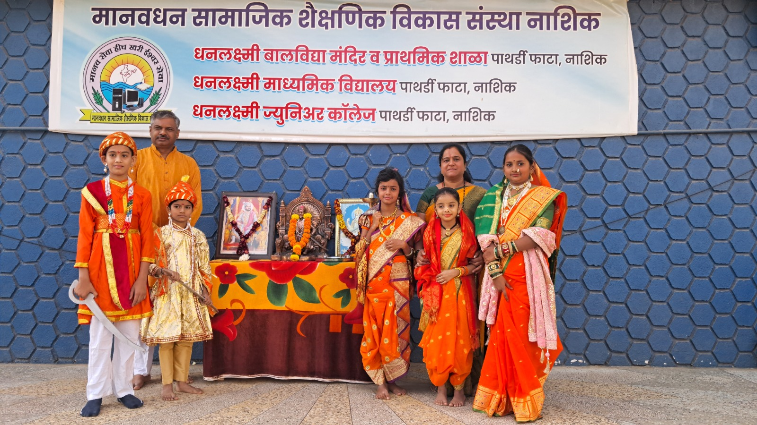
February 2027
S | M | T | W | T | F | S
 | 1 | 2 | 3 | 4 | 5 | 6
7 | 8 | 9 | 10 | 11 | 12 | 13
14 | 15 | 16 | 17 | 18 | 19 | 20
21 | 22 | 23 | 24 | 25 | 26 | 27
28
CLASS ACTIVITIES
1st to 4th Poetry Rhymes
5th to 8th Marathi Poetry Singing Competition
EVENTS
1st Feb Picnic
26th Feb Marathi Day & Sci Day
HOLIDAYS
19th Feb Chht Shivaji Maharaj Jayanti

Slide 12

March 2027
S | M | T | W | T | F | S
 | 1 | 2 | 3 | 4 | 5 | 6
7 | 8 | 9 | 10 | 11 | 12 | 13
14 | 15 | 16 | 17 | 18 | 19 | 20
21 | 22 | 23 | 24 | 25 | 26 | 27
28 | 29 | 30 | 31
CLASS ACTIVITIES
1st to 4th Poetry Rhymes
5th to 8th Marathi Poetry Singing Competition
EVENTS
8th Mar Women’s Day
8th Mar to 19th Mar IX std II Semester
30th Mar IX std Open House
HOLIDAYS
6th Mar Mahashivratri
9th Mar Bakri Eid
22nd Mar Dhuliwandan
27th Mar Rangpanchmi

Slide 13

April 2027
S | M | T | W | T | F | S
 |  |  |  | 1 | 2 | 3
4 | 5 | 6 | 7 | 8 | 9 | 10
11 | 12 | 13 | 14 | 15 | 16 | 17
18 | 19 | 20 | 21 | 22 | 23 | 24
25 | 26 | 27 | 28 | 29 | 30
CLASS ACTIVITIES
Nil
EVENTS
1st April New X std Batch Starts
1st April to 11th April II Semester
HOLIDAYS
14th April Dr. Babasaheb Ambedkar Jayanti
12th April to 14th June Summer Vacation

